Slide 1
Metaball Study

Slide 2
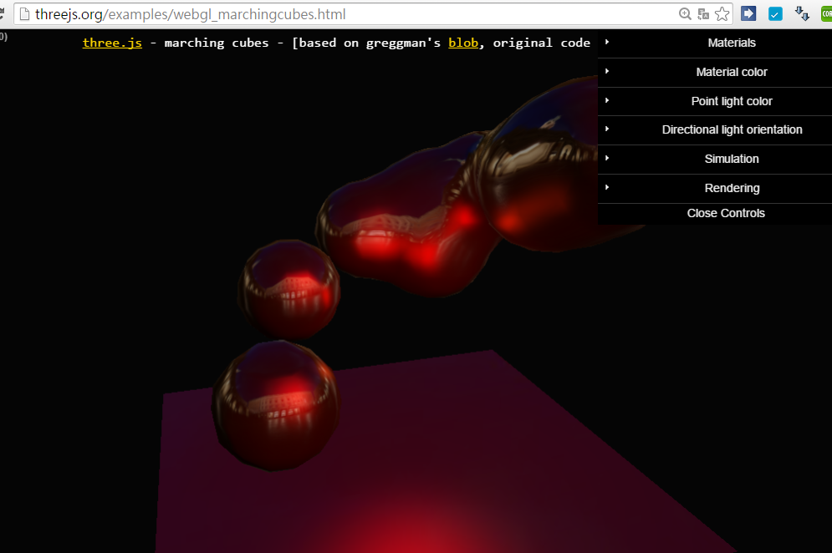
Official ThreeJS + MarchingCube Example

Slide 3
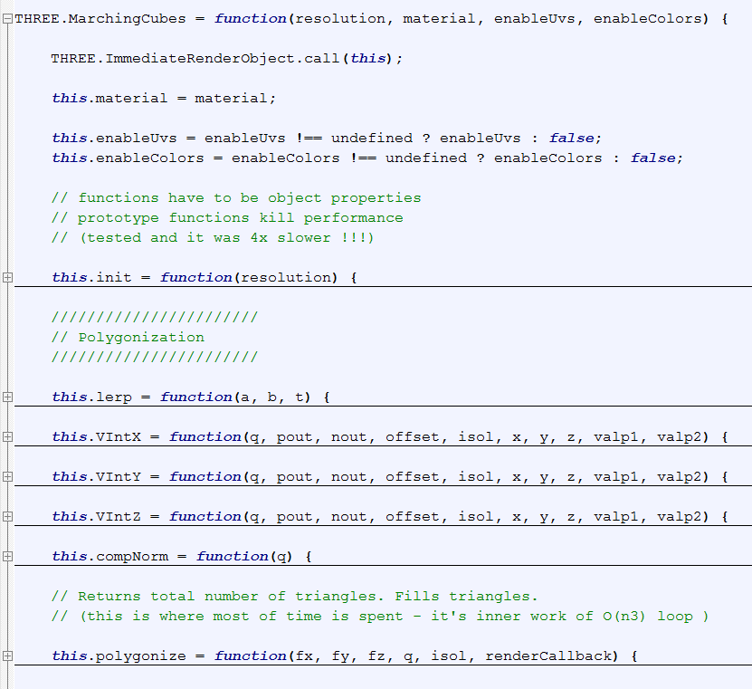
MarchingCube Class

Slide 4
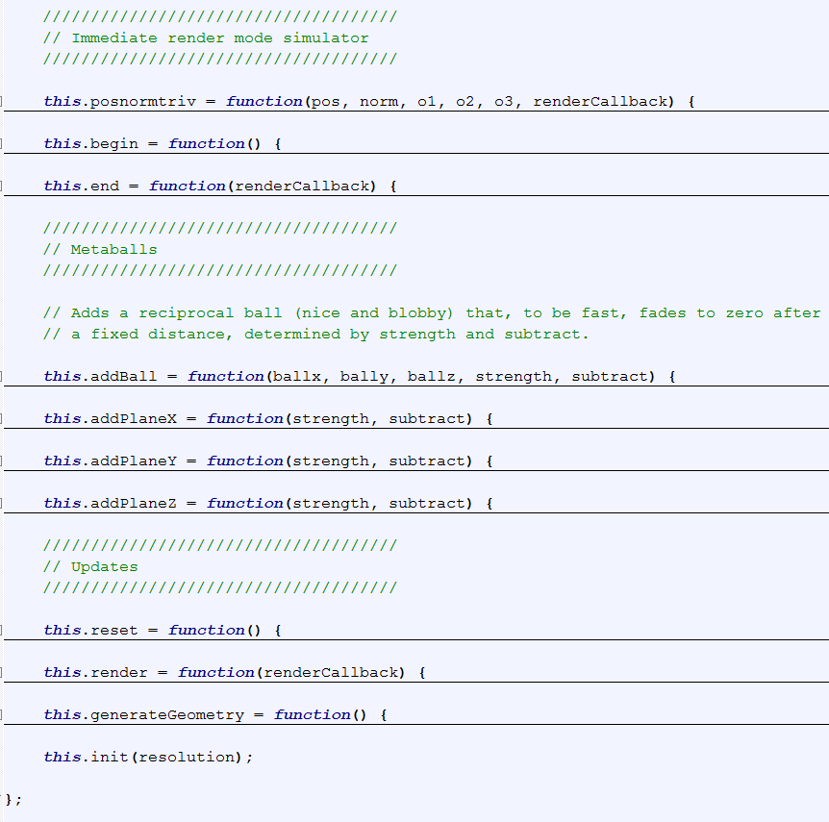

Slide 5
Constructor
this.init (resolution)
Size = resolution (max: 32, practically)
Size3 = size*size*size
Field = new Float32Array (size3);
Normal_cache = new Float32Array (size3*3);

Slide 6
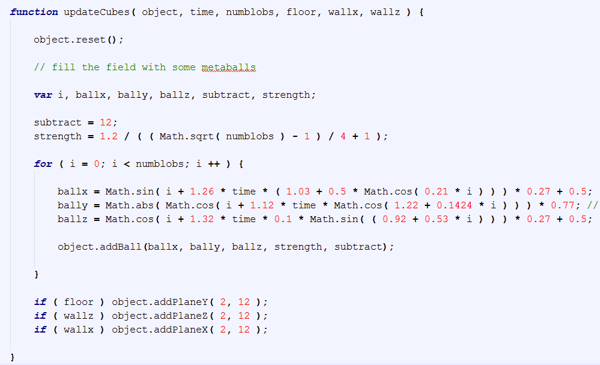
In Calling Program
[0.23, 0.77]^3

Slide 7
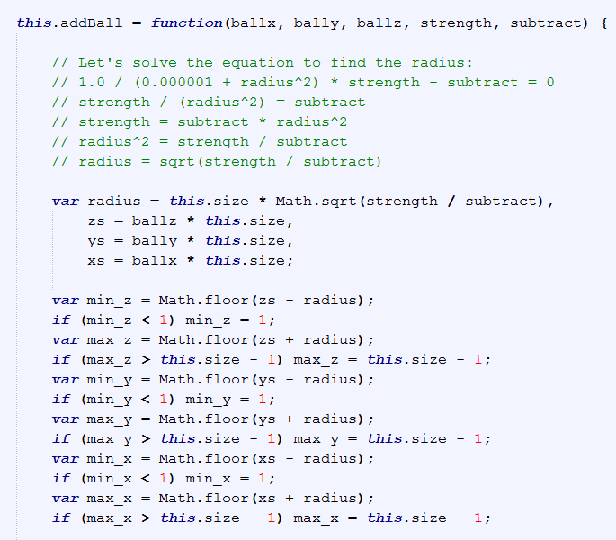
Metaball Details
In normalized scale, multiplied by size (i.e., resolution)
Range of ball
[min_xyz, max_xyz],
all integers
Max. range:
[1, this.size – 1]^3

Slide 8
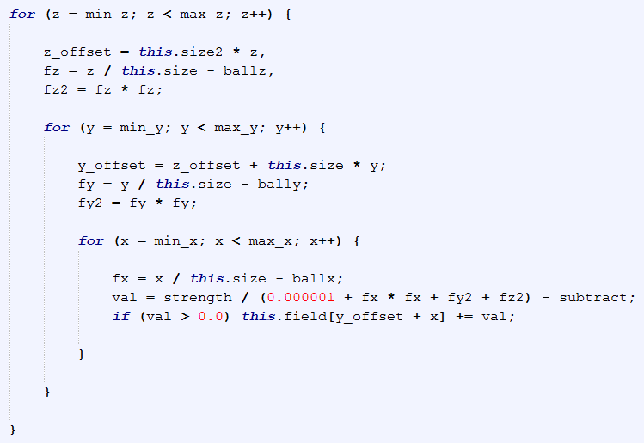
Only modify the field value within
[min_x, max_x] x [min_y, max_y] x [min_z, max_z]
Back to normalized scale
y_offset, z_offset:
help to access the triple array [x][y][z]

Slide 9
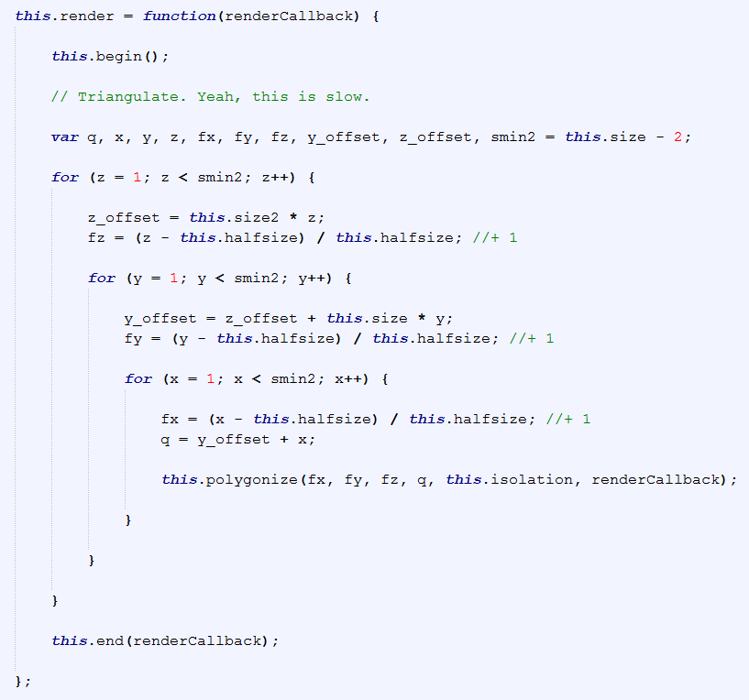
Render
1.0

Slide 10
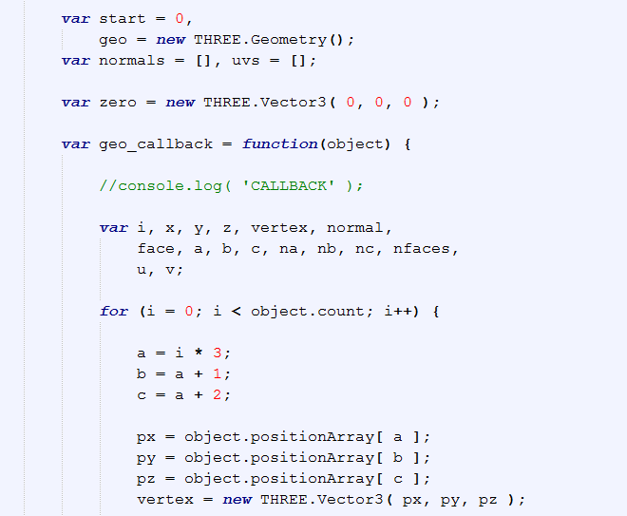
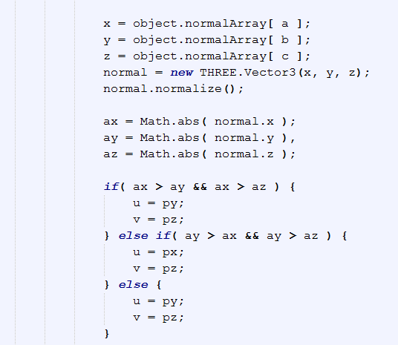
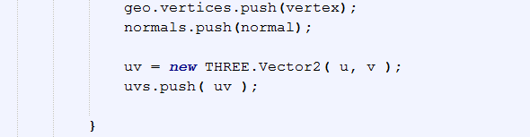

Slide 11
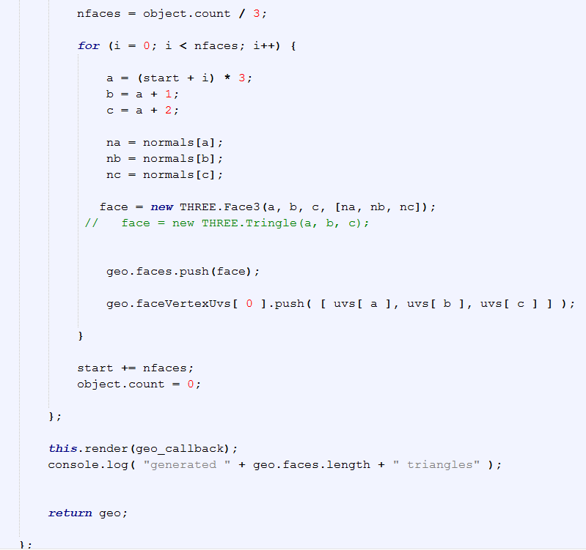

Slide 12
Comments
Marchingcube.js, Mr. Doobs
https://github.com/mrdoob/three.js/blob/dev/examples/js/MarchingCubes.js
Use ImmediateRenderObject call
Lookup table
EdgeTable, TriTable (from Paul Bourke’s page)
JavaScript Int32Array

Slide 13
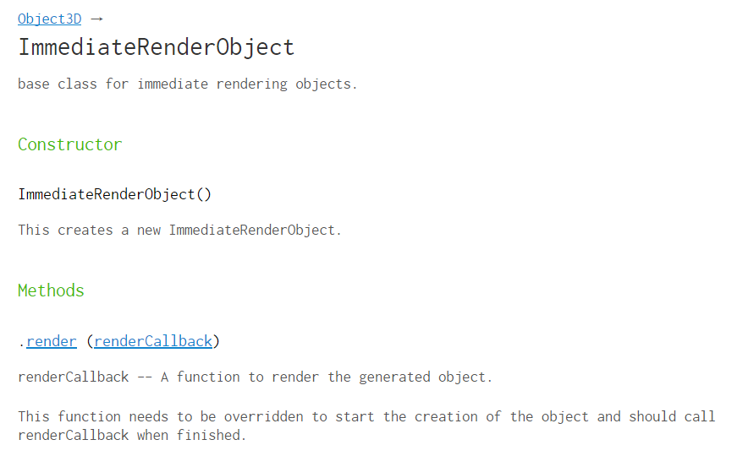

Slide 14

Test run

Slide 15
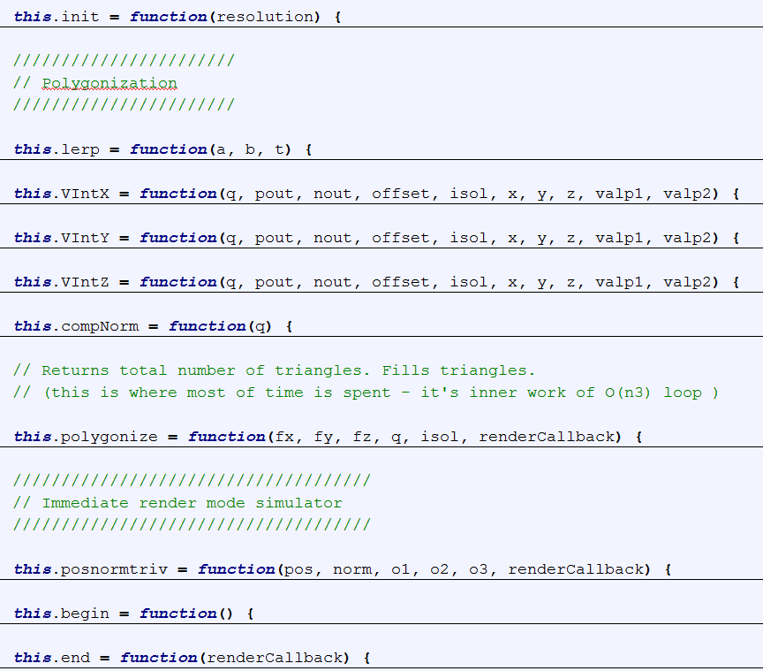

Slide 16
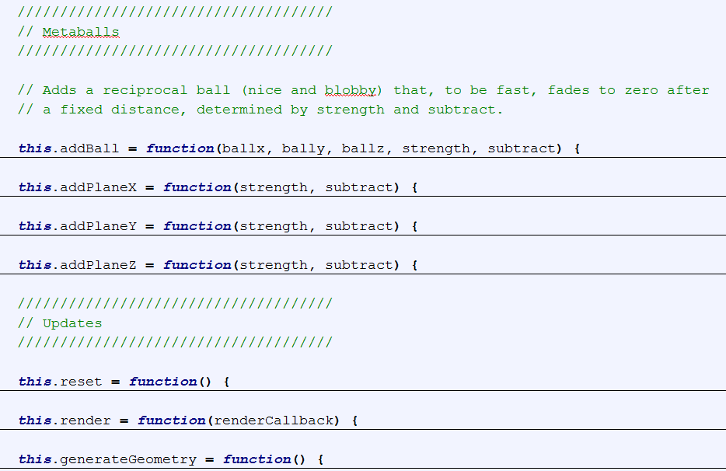
Clear cache
Calls polygonise: the real stuff
Can produce three.js geometry?!

Slide 17
